Slide 1
Enterprise Services Application Module (ESAM)
For the MTS/T-BERD 4000

Slide 2
Product Overview
Module for JDSU’s Award Winning MTS/T-BERD 4000 Platform
Enterprise Troubleshooting
  Physical Media Tests for LAN Cabling
  Network Connectivity Tests
  Network Discovery
  Network Statistics
  Packet Capture and Expert Analysis
Platform Options
  Voice over IP Emulation
  WiFi Connectivity Analysis
  Optical Power Meter/Visual Fault Locator
  Fiber End-Face Inspection and Automated Analysis
  Additional Modules Available
Notes:
Physical media testing (Speed certification of copper Ethernet cabling – including Plan-Um software)
Connectivity tests from Ethernet interface discovery (what speed and duplex are being advertised) to layer 4 port connectivity (going beyond ping to verify that you can communicate with an IP device on a specific UDP/TCP port)
Discovery: discover IP devices on and off the subnet. Use SNMP (v1/v2/v3) to obtain critical information about devices and how they are performing.
Statistics: show link and vlan utilization, protocol distribution. Deep-packet wire speed counters (pre-defined and user defined) allow for statistics to be gathered on EVERY packet in the network. User defined counters can be deep within the packet – including specific payload text strings.
Capture and analysis: true wirespeed capture (never miss a frame) into a 1GB buffer. Pre-capture filters and triggers. Industry-standard PCAP file format. Wireshark on-board.

Slide 3
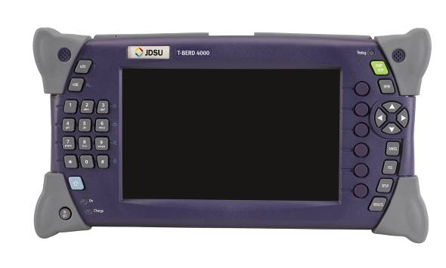
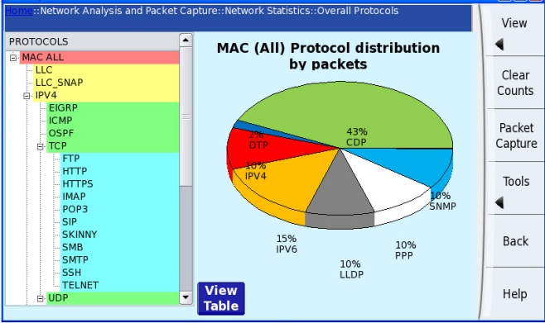
Platform Overview
Advanced field design
2 Slot-Modular
Rugged
7’’ High Visibility TFT Color Screen
Landscape format
Indoor/Outdoor usage
- Touch screen
6 Soft Keys
- Context-dependant
- SW compatibity
Testing indicator
Microphone
Home key
Start/Stop & Enter keys
Numerical Keypad
- Number & Text edition
Menu/Sub-menu shortcuts
7’’
Navigation Key Pad
5 Direct Access Keys
- Easy page selection
- No pop-up menus
AC/DC Power supply and Battery charge indicators
Molded bumpers
Size (HxWxD): 5.3x10.2x3.5 inch
13.5x26x9 cm
Weight: 3lbs/1.4 kg
Battery-operated
Long Life

Slide 4
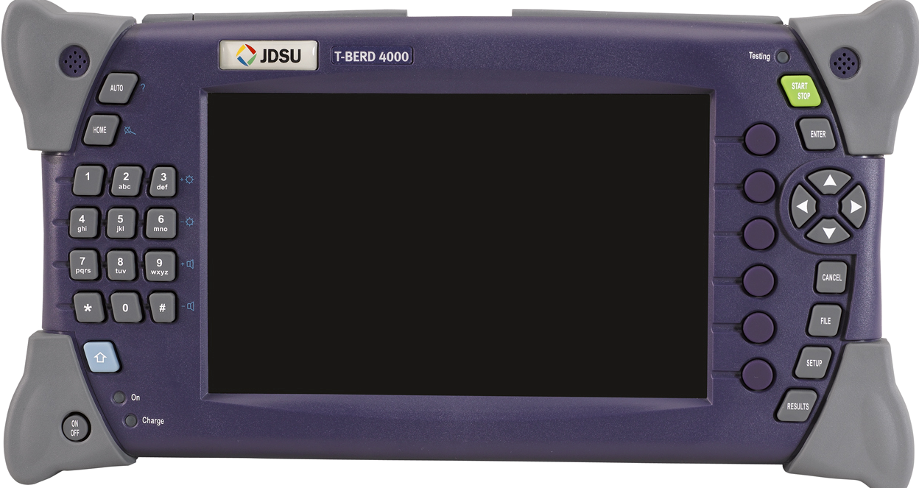
Workflow-Based User Interface

Slide 5
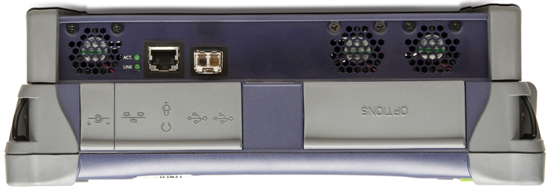
Test Ports
RJ-45 10/100/1000 electrical Ethernet
Single SFP (1000BASE-SX for optical Ethernet included – Other SFPs available)

Slide 6

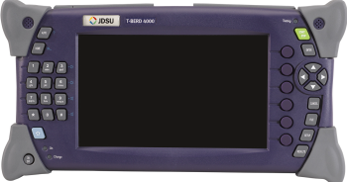
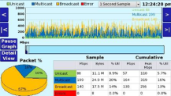
Test Access
Some tests can be done from a drop
  In switched networks you will ONLY be able to see broadcast traffic AND multicast/unicast traffic that is switched out the interface you are connected to
Some tests (network statistics and capture) require you see ALL traffic, so you need to:
  Mirror (monitor) a switch port
  Use a tap (aggregating)
Mirrored ports

Slide 7
LAN Workgroup Responsibilities
End Devices:
Servers
Clients
Other IP Hosts
TCP Response Time
DNS Lookups
Application Response Time
Network Statistics
Packet Capture and Analysis
VoIP Emulation
Network:
Ethernet Switches
IP Routers
Firewalls
Ethernet Port Settings
Power over Ethernet (PoE)
Cisco/Link Layer Discovery
DHCP (IP Addressing)
Ping/Trace Route
TCP/UDP Port Connectivity
Physical Media:
Shielded Twisted Pair (STP)
Unshielded Twisted Pair (UTP)
Multi Mode Fiber (62.5/125 or 50/125)
Single Mode Fiber (9/125)
Length, Wiremap
Speed Certification
Pristine End Face
Insertion Loss
OTDR

Slide 8
Problems Solved - Why can’t users Connect?
Is the drop dead?
  Cabling issue or switch issue
No IP configuration?
  DHCP server or local settings
Can’t resolve host names?
  DNS server
Can’t reach device with Ping?
  Routing issue
Can’t reach layer 4 port?
  Firewall issue

Slide 9
Problems Solved - What’s on the Network?
Is everything that is supposed to be on the network present and accounted for?
  Switches, routers, end devices, etc
  Drill into details
Is anything on the network that is not supposed to be there?
  Switches, routers, wireless access points, etc

Slide 10
Problems Solved - Why is the Network slow?
Stems from user complaints
Is the cause the network or the application?
If the cause is the network, what’s wrong?
  Over-utilization?
  VLAN/Prioritization?
  Duplex mis-matches?
If the cause is the application, what’s wrong?
  TCP window sizing?
  Server resource issues?

Slide 11
Problems Solved - How is the Network being used?
What and who are consuming the capacity (bandwidth) of the network?
  What protocols (at any layer) are present on the network and how much bandwidth are they using?
  Are any protocols on the network that shouldn’t be?
  Who is consuming the most bandwidth and why?
  Is there excessive multicast or broadcast traffic?
  Are there any errors (typically Ethernet FCS errors)?

Slide 12

Product Details

Slide 13
Workflows
Physical Media Tests for LAN Wiring
Network Connectivity Tests
Network Discovery
Network Statistics
Packet Capture and Expert Analysis
VoIP (Option)
Wireless LAN Analysis (Option)
Optical Testing (Options)
  Fiber Inspection
  OPM/VFL

Slide 14
Physical Media Tests
Copper (S/UTP LAN cabling via standard RJ-45 connector)
  Wiremap (opens, shorts, miswires, split pairs),
  Length
  Distance to opens/shorts
  Ethernet speed certification via SNR, Skew and BERT (100BASE-TX and 1000BASE-T)
  Planning and documentation with included Plan-Um software
    Job information
    Custom cable types
    Auto test
  Tone generation
    4 tones (analog)
    Pin, pair, all pins, pins 1&8
  Link Flash (AKA Hub Flash)
Test connectivity
  Connect direct to physical media (no active equipment)
  Single-ended testing (basic)
  Dual-ended testing for most tests

Slide 15
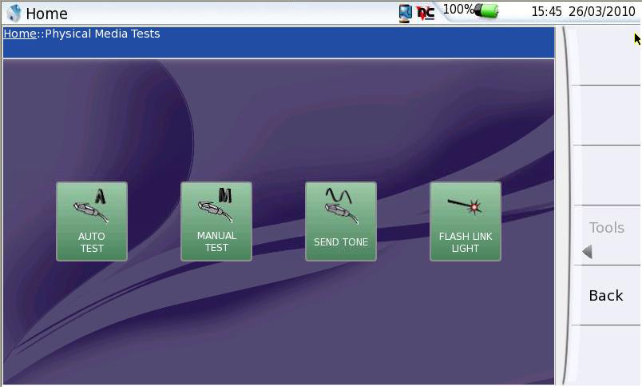
Physical Media Tests – Main Menu

Slide 16
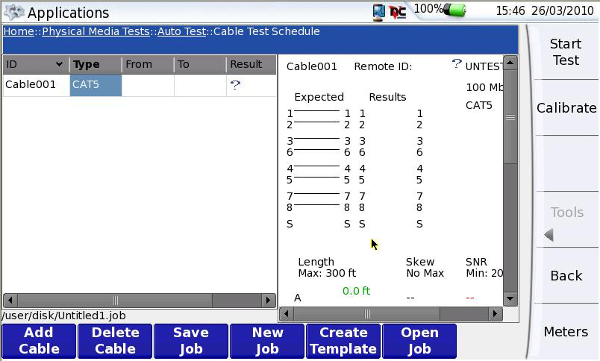
Physical Media Tests – Auto Test

Slide 17
Network Connectivity Tests
Power over Ethernet
Ethernet port discovery
  Report advertised speed and duplex
DHCP
DNS
Ping
Traceroute
Display CDP/LLDP packet information
TCP/UDP Port Test (firewall blocking)
Context-Sensitive Capture
To Network
Individual Drop
Notes:
Scripting in roadmap

Slide 18
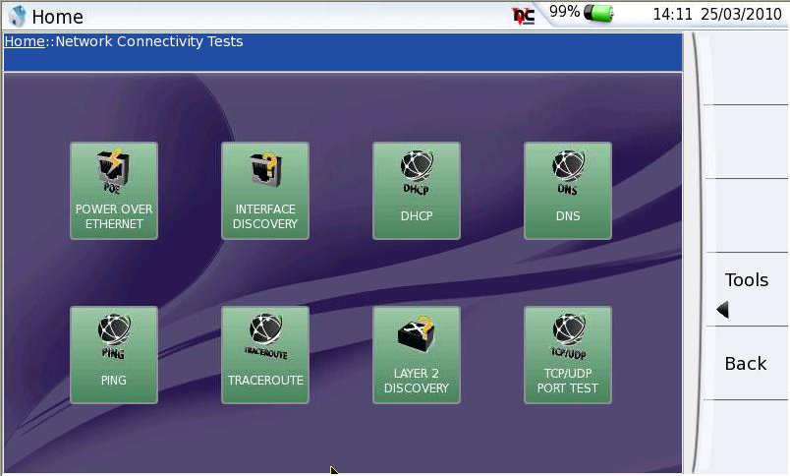
Network Connectivity Tests – Main Menu

Slide 19
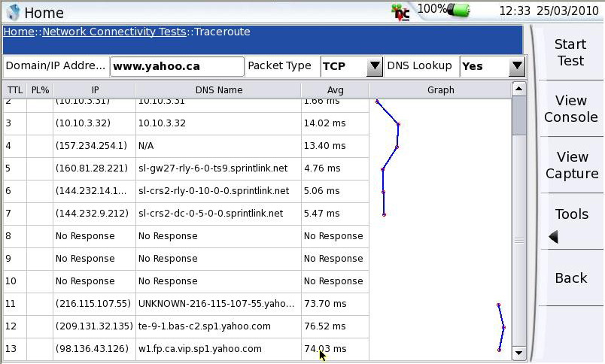
Network Connectivity - Traceroute

Slide 20
Discovery
Discover IP devices
Graphical representation of what is on the network
Use SNMP (v1/v2/v3) to obtain critical information about devices and how they are performing
To Network
Individual Drop

Slide 21
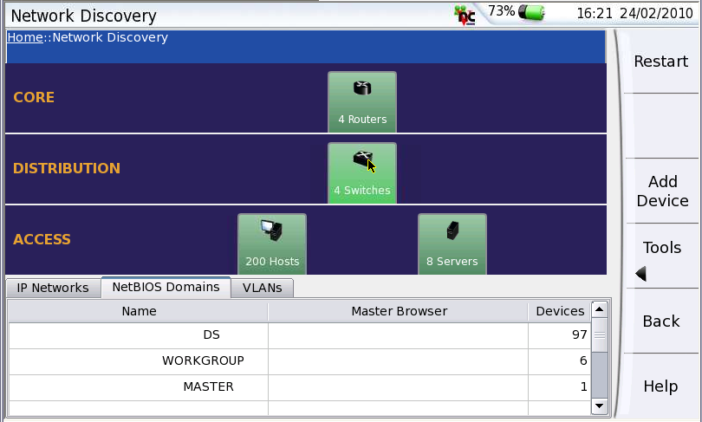
Network Discovery – Summary View
Notes:
21
21

Slide 22
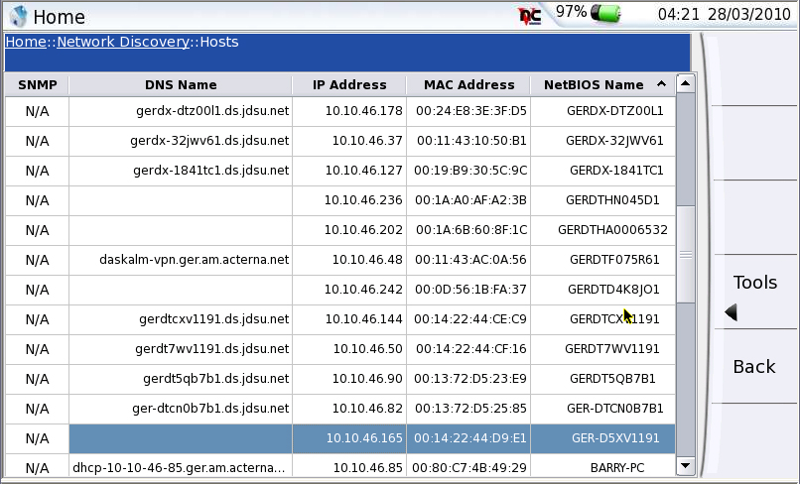
Network Discovery – Hosts
Notes:
22
22

Slide 23
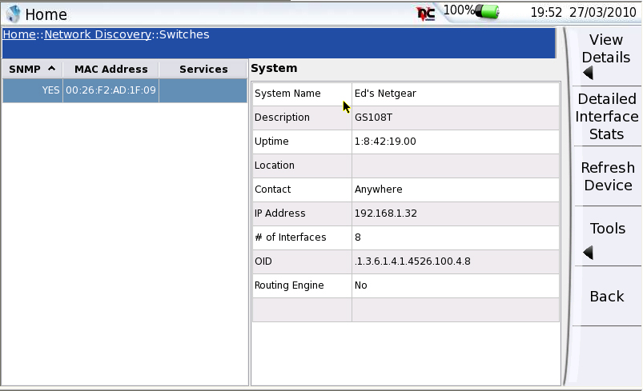
Network Discovery – Switch Summary

Slide 24
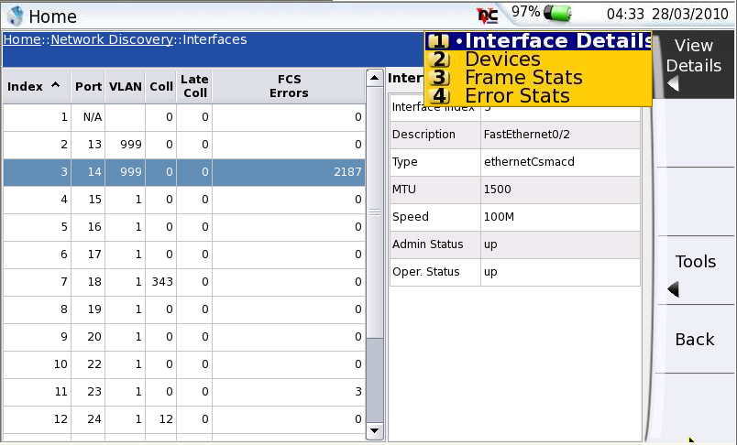
Network Discovery – Switch Interface Details

Slide 25
Network Statistics
Show link, VLAN, and subnet utilization trending
Show link protocol distribution
Show top talkers on link – direct link to filtered capture
Deep-packet wire speed counters (pre-defined and user defined) allow for statistics to be gathered on EVERY packet in the network
User defined counters can be deep within the packet – including specific payload text strings
Mirrored ports

Slide 26
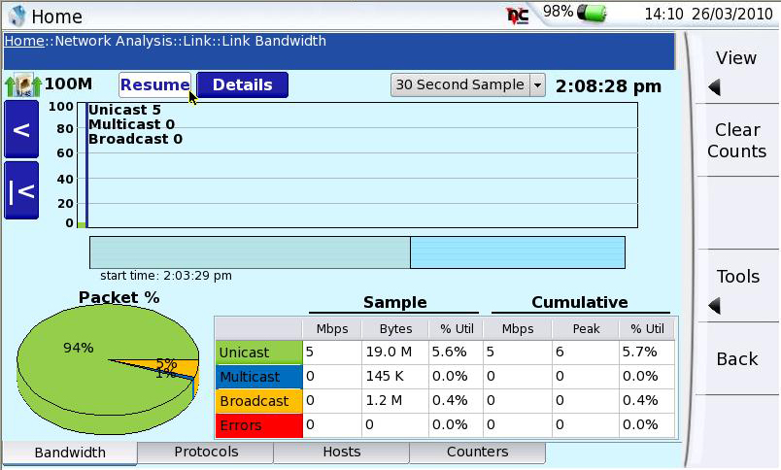
Network Statistics - Overall Bandwidth
Notes:
26
26

Slide 27
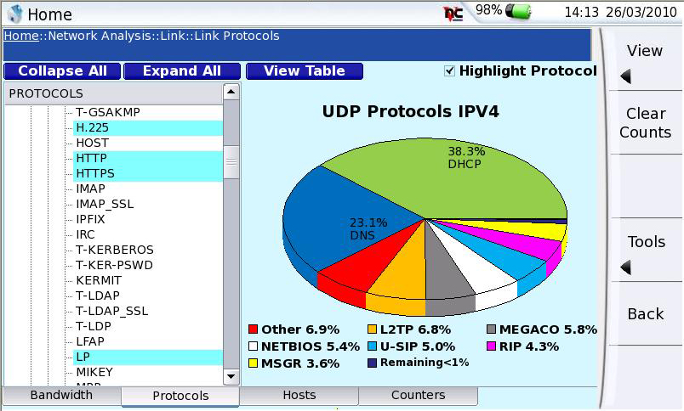
Network Statistics – Protocol Distribution

Slide 28
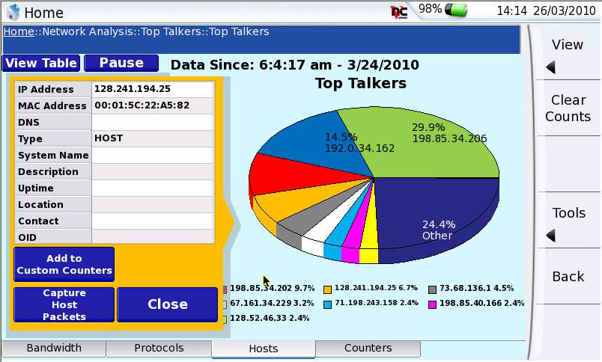
Network Statistics – Top Talkers

Slide 29
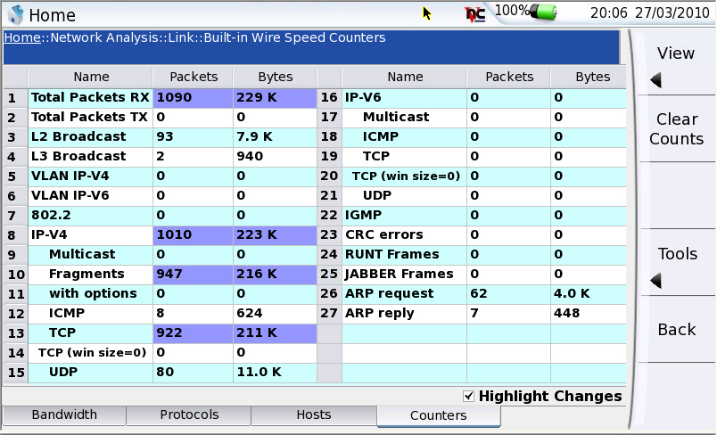
Wire Speed Counters – Pre-Defined

Slide 30
Packet Capture and Analysis
True wire speed capture (never miss a frame)
1GB buffer
Pre-capture filters
  Basic and Complex
Industry-standard PCAP file format
Wireshark on-board
J-Mentor expert analysis
Mirrored ports

Slide 31
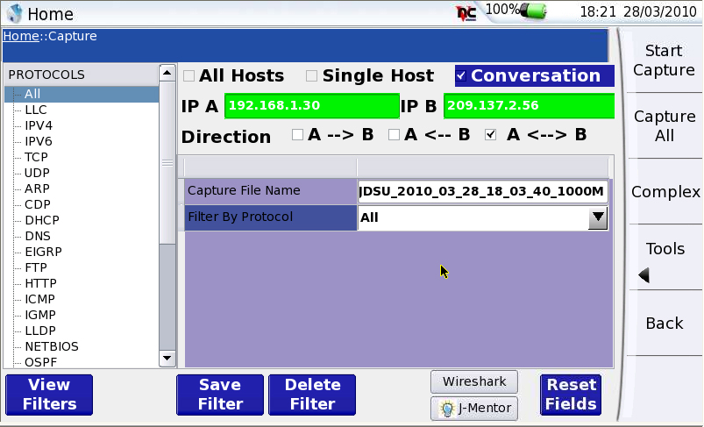
Packet Capture - Basic

Slide 32
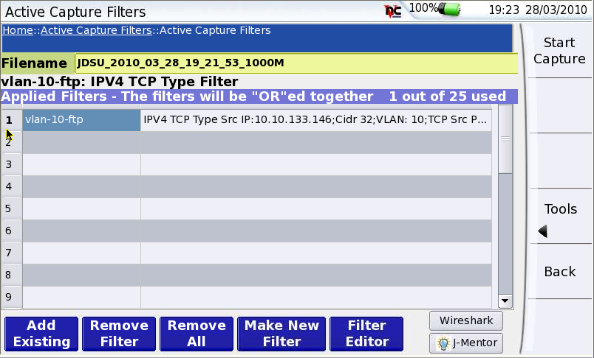
Packet Capture - Complex
Notes:
32

Slide 33
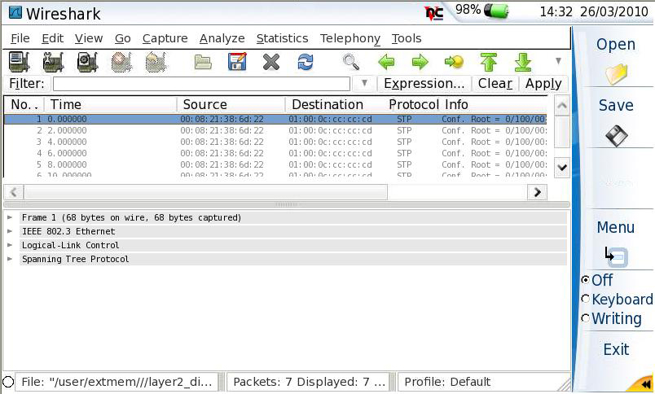
Analysis with Wireshark

Slide 34
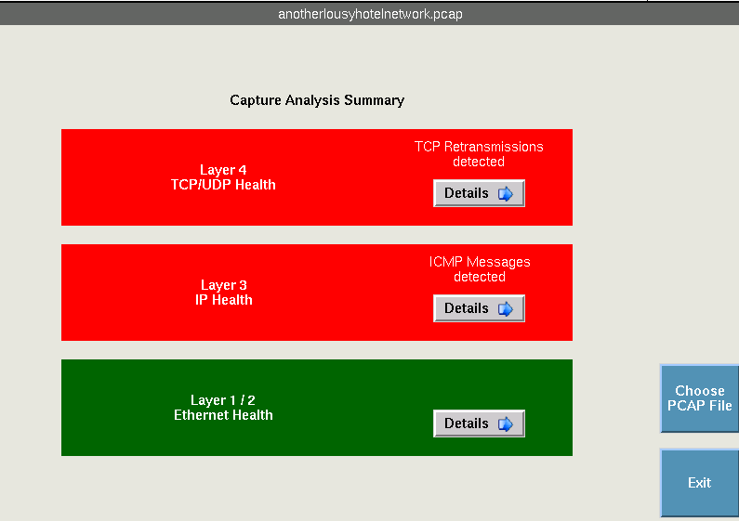
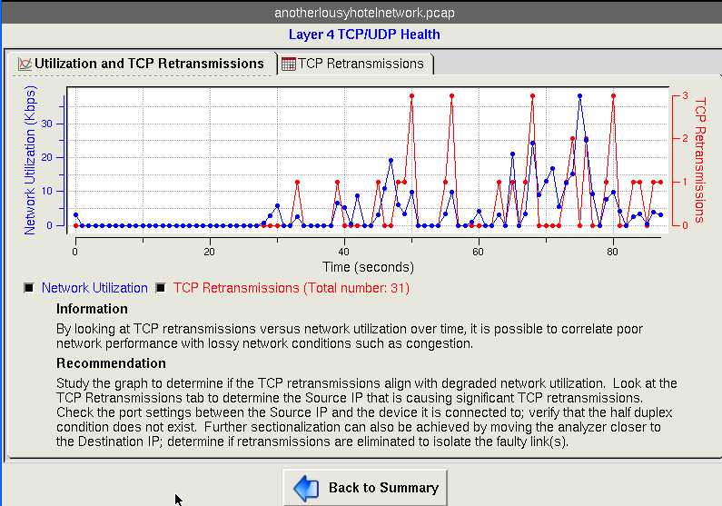
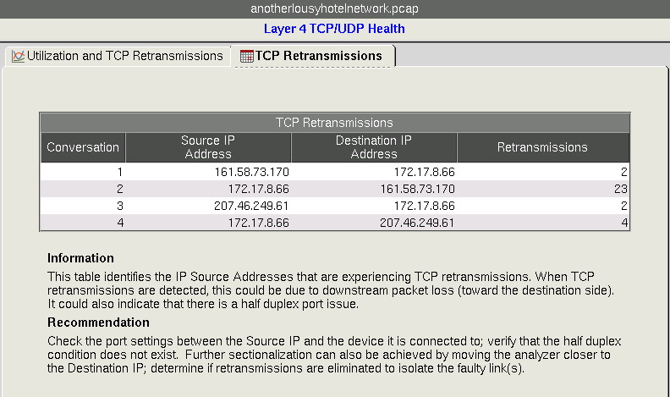
Expert Analysis with J-Mentor

Slide 35
Ordering information
North America Packages
Package ordering number | Description
TB4-DIS-LAN | ESAM WITH T-BERD 4000 BASE
TB4-DIS-LANVOIPWLAN | ESAM WITH T-BERD 4000 BASE with VoIP and WLAN
TB4000-GOVT-LAN | ESAM WITH T-BERD 4000 BASE, VoIP CISCO & UNISTIM Call Mgr SW
TB4-DIS-LANOPMVFL | ESAM WITH T-BERD 4000 BASE with OPM, VFL & SCOPE
TB4-DIS-LANPKG | ESAM WITH T-BERD 4000 BASE VOIP, WLAN, OPM, VFL, SCOPE
EMEA, UK, LAM, AsiaPac
Package ordering number | Description
MTS4-DIS-LAN | ESAM WITH MTS 4000 BASE - UK & EMEA, LA, ASIAPAC POWER SUPPLIES
MTS4-DIS-LANVOIPWLAN | ESAM WITH MTS 4000 BASE with VoIP and WLAN - UK & EMEA, LA, ASIAPAC POWER SUPPLIES
MTS4-DIS-LANOPMVFL | ESAM WITH MTS 4000 BASE with OPM, VFL & SCOPE - UK, EMEA, LA, ASIAPAC POWER SUPPLIES
MTS4-DIS-LANPKG | ESAM WITH MTS 4000 BASE VOIP, WLAN, OPM, VFL, SCOPE - UK, EMEA, LA, ASIAPAC POWER SUPPLIES
Australia
Package ordering number | Description
MTS4-DIS-LAN-AU | ESAM WITH MTS 4000 BASE - AU POWER SUPPLY
MTS4-DIS-AU-LANVOIPWLAN | ESAM WITH MTS 4000 BASE with VoIP and WLAN - AU POWER SUPPLY
MTS4-DIS-AU-LANOPMVFL | ESAM WITH MTS 4000 BASE with OPM, VFL & SCOPE - AU POWER SUPPLY
MTS4-DIS-AU-LANPKG | ESAM WITH MTS 4000 BASE VOIP, WLAN, OPM, VFL, SCOPE - AU POWER SUPPLY

